Slide 1

Movie Dataset Analysis
DATA ALPHAS

Slide 2
Introduction
We are given a movie system dataset which is made up of different types of variables. These variables helped us get fruitful insights that will be viewed in this presentation.
The variables are:
Movie id and Movie names
Movie Directors and Casts
Ratings and Runtime
Plot keywords and tags

Slide 3
Data Handling
In this raw dataset, we were handling 9 million+ entries with nulls accounted. So in handling the missing entries, we did the following:
Merged the “imdb”, “train”, and “movies” csv’
Dropped the “budget” column
Dropped the “Nulls” in the dataset
Added a “Content” column by combining the “directors”, “Genres”, “Plot_keywords”, and “title_cast” columns
We Lastly grouped “titles” and “content” columns by the ratings.
After all this processing, we managed to have 12000+ entries and we found the following insights.

Slide 4
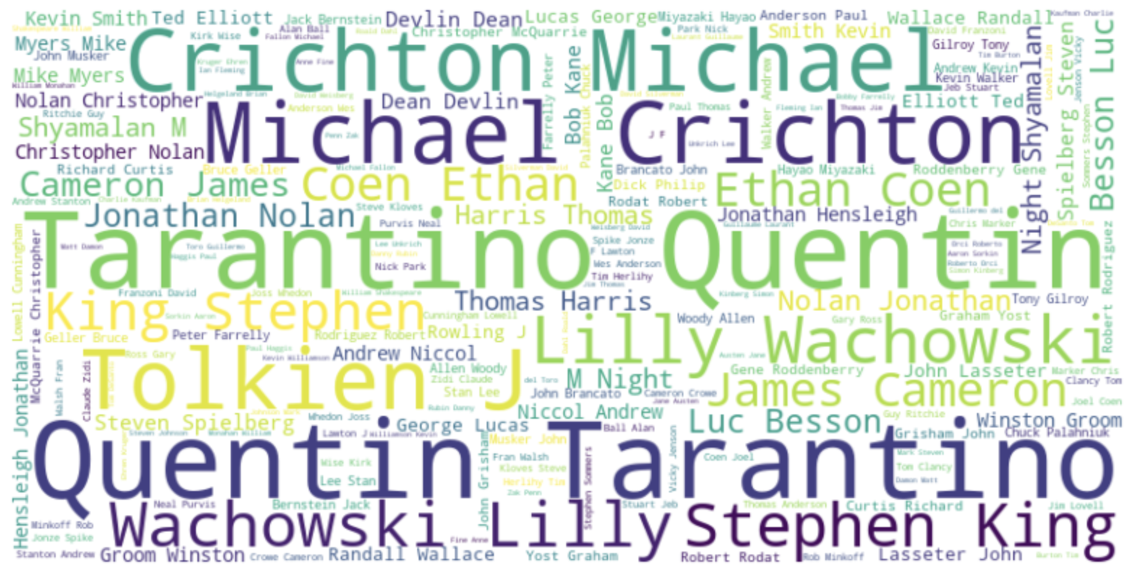
Directors in our datasets

Slide 5
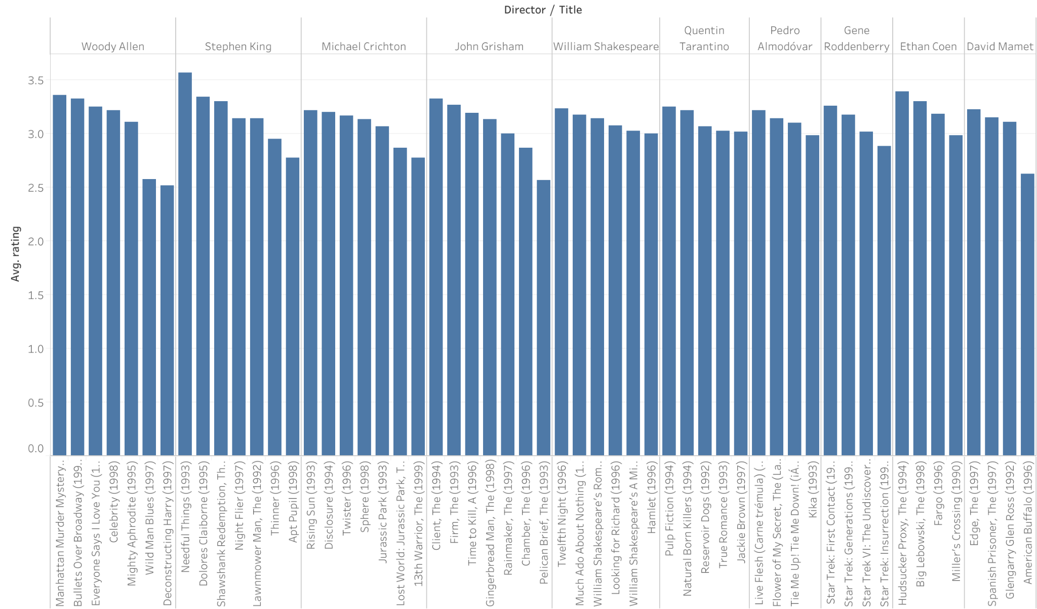
Top 10 directors

Slide 6
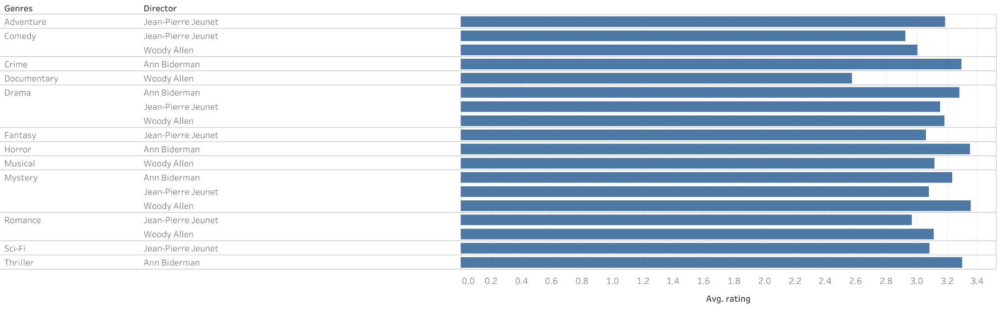
Best Directors per genre
Aravage Rating

Slide 7
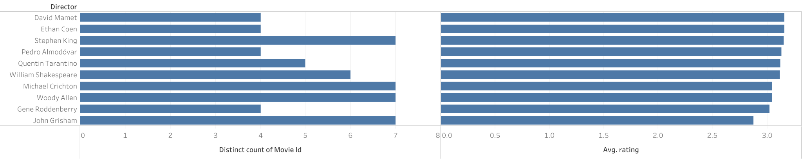
Top 10 Directors With The Most Viewed Movies
Number Of Movies
Average Rating

Slide 8
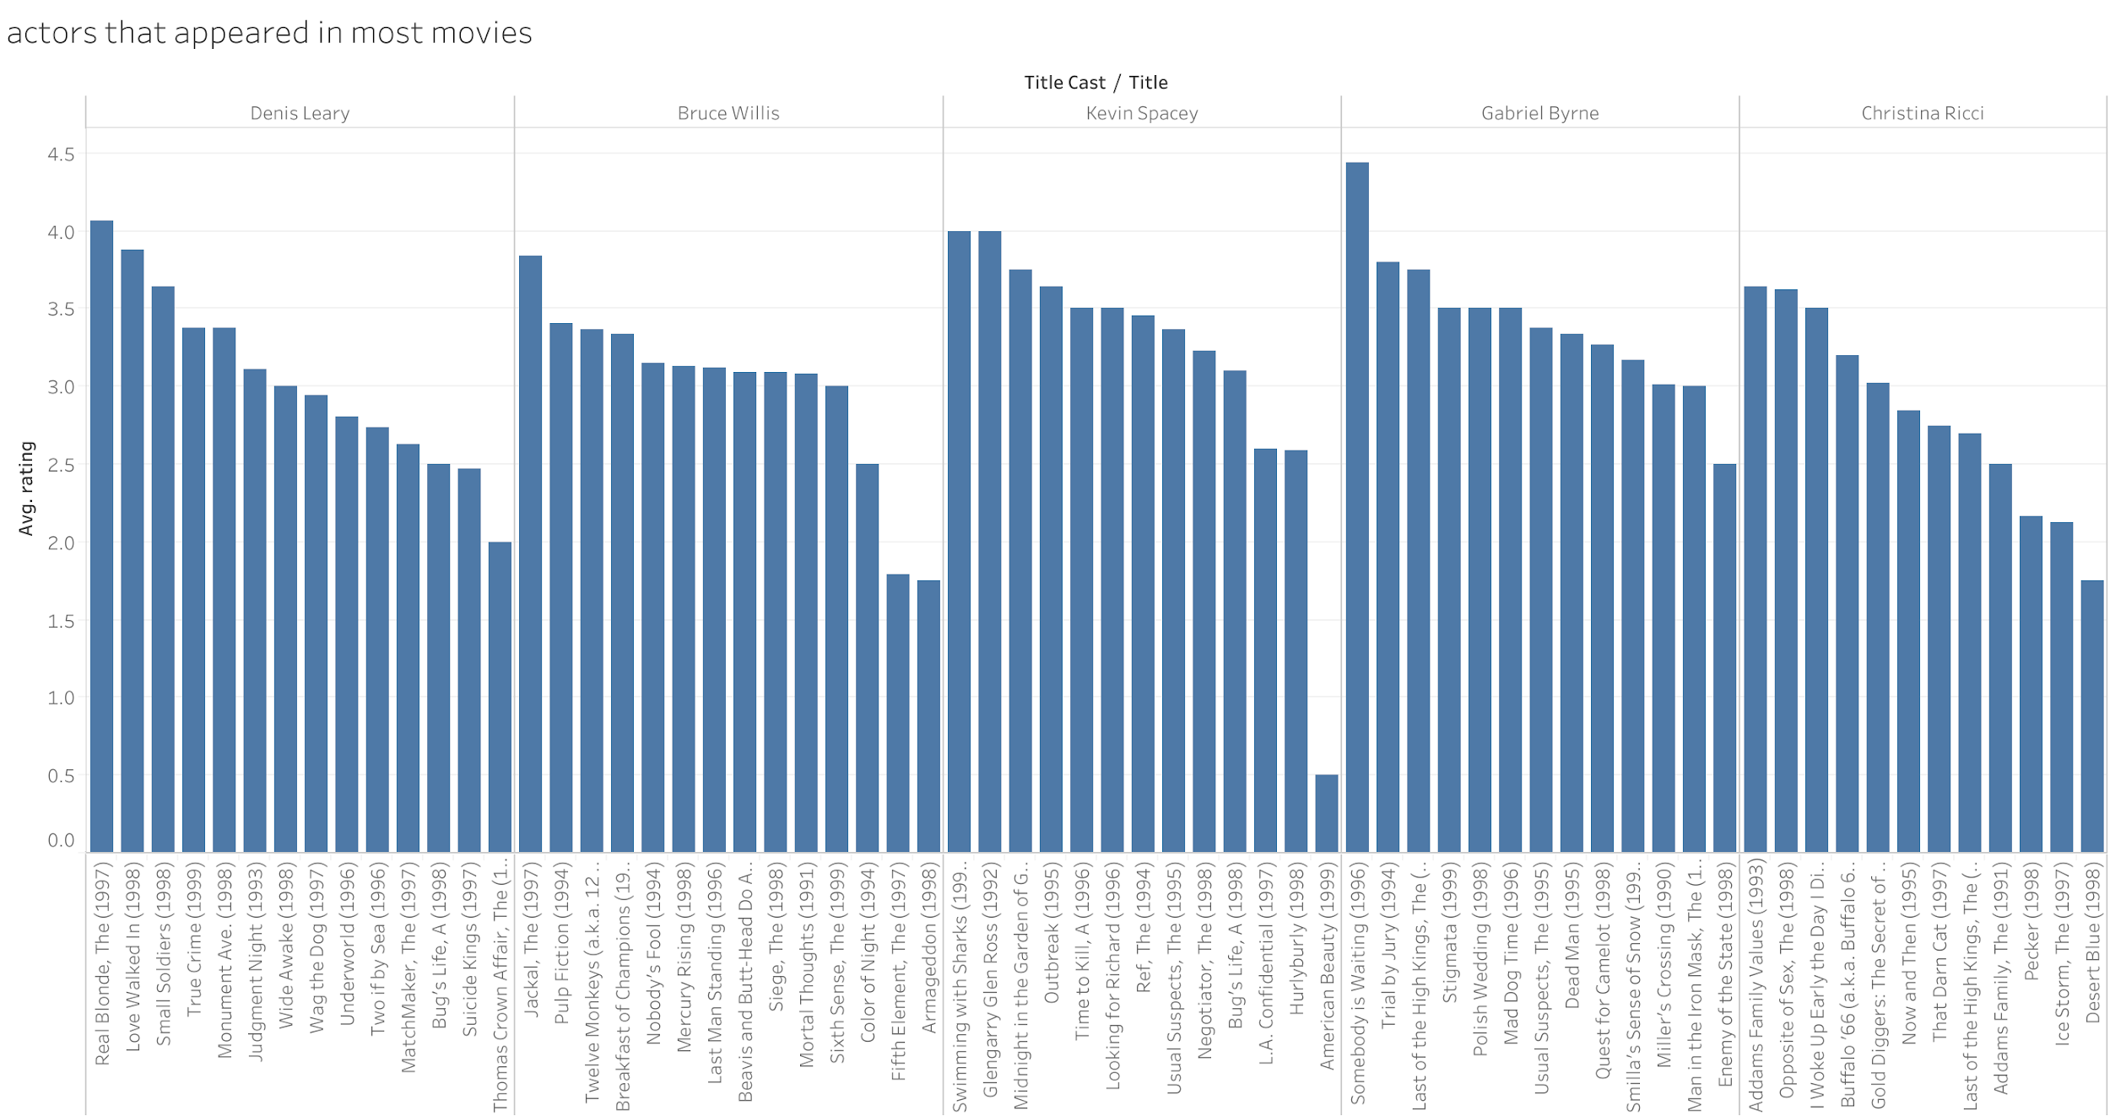
Top 5 Actors and their top rated movies

Slide 9
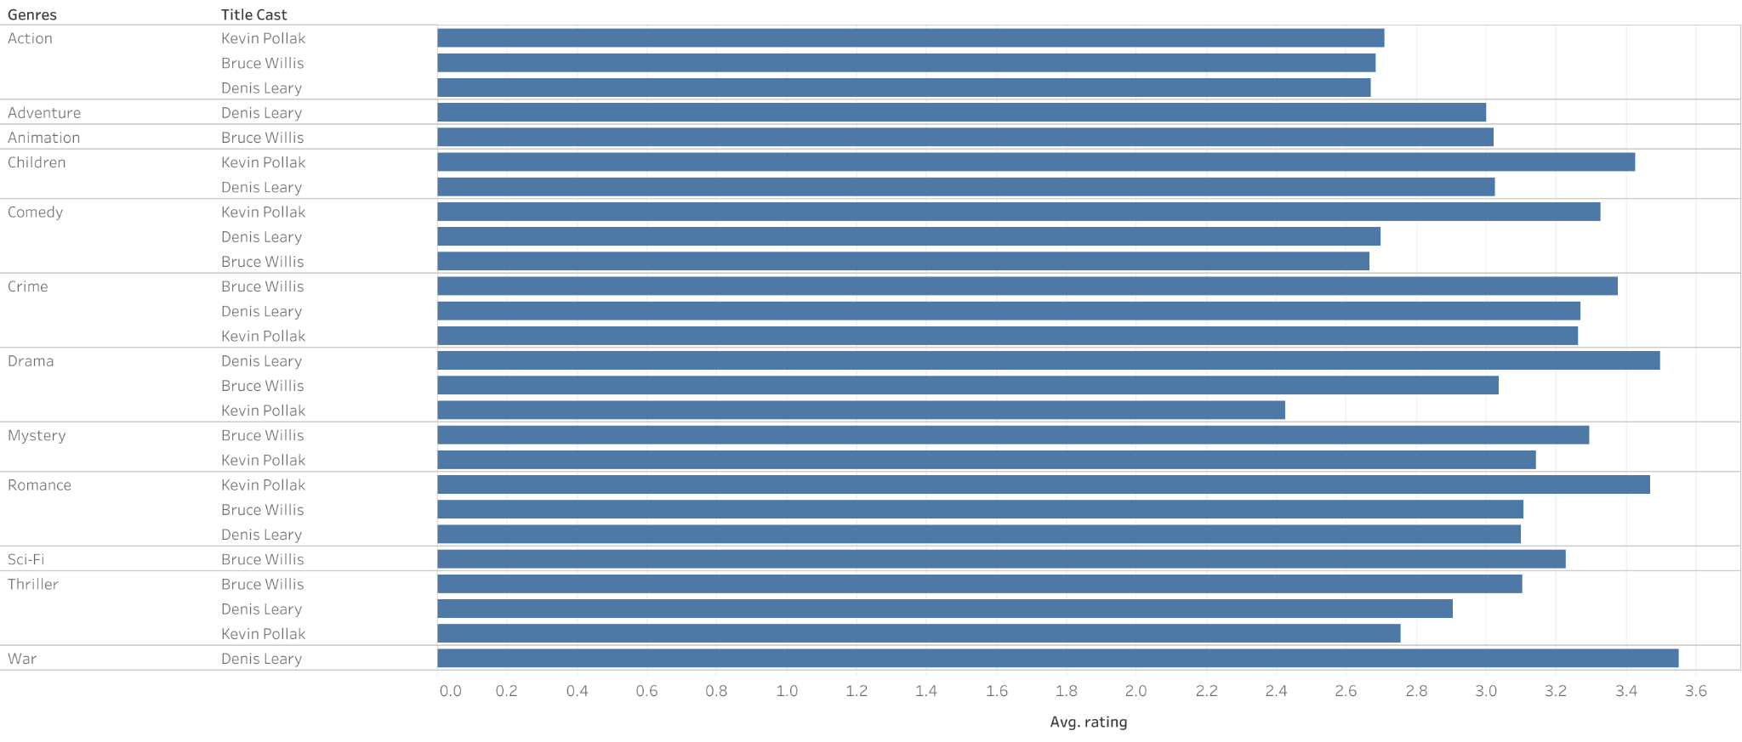
Top Actors In Different Genres
Average Rating

Slide 10
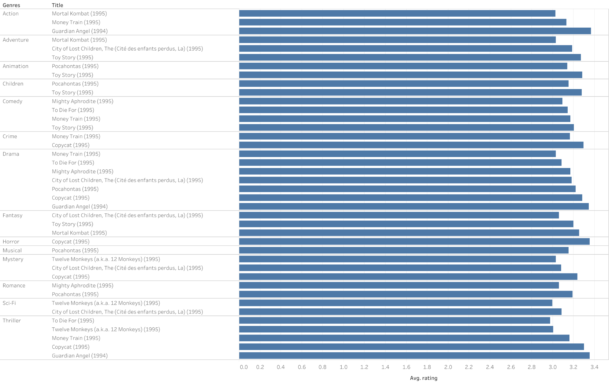
Top Rated Movies Per Genre
Average Rating

Slide 11
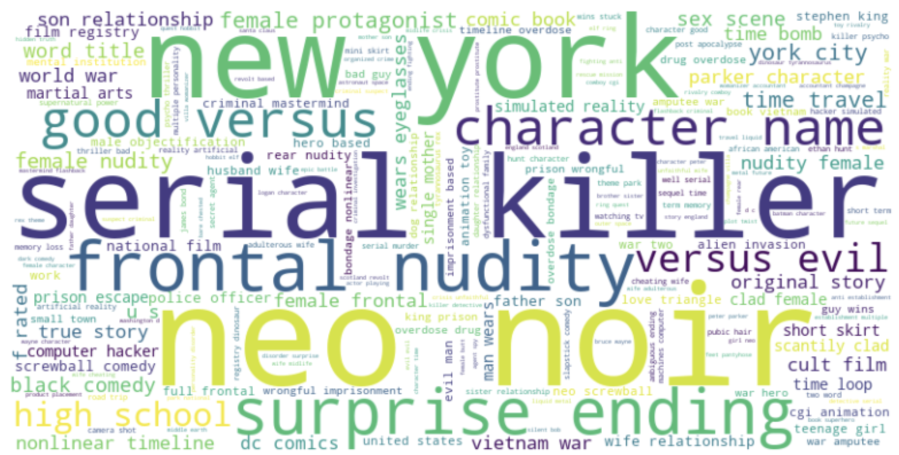
Most Used Plot Keywords

Slide 12


